Slide 1
Intro to Programming
Part of a modern scientist’s toolkit.
Programming and Data Analysis for Modern Neuroscience
Spring 2020

Slide 2
Why would you want to add programming to your toolkit?
The need for programming in modern neuroscience.

Slide 3
How would you ____ complex systems & big data?
GWAS
Connectome
RNA-Seq
Multiomics
Models
Time series

Slide 4
How would you ____ complex systems & big data?
GWAS
analyze (efficiently)
Connectome
RNA-Seq
visualize
interpret
test
Multiomics
Models
Time series
understand

Slide 5
How would you interact with data?

Slide 6
A few programming basics.

Slide 7
Programming Languages (not comprehensive)
https://craftofcoding.wordpress.com/2017/01/09/my-periodic-table-of-programming-languages/

Slide 8
Programming Languages
High level
Low level
Human
speech
Python,
MATLAB
C/C++
Assembly
language
Machine
code
Human-readable code that must be compiled into machine code for a CPU.
Human-readable (somewhat) instructions that mostly map to machine instructions.
“For each integer from one to ten, display its value.”
for i in 1:10:
print(i)
for(int i=1; i<=10; ++i){
std::cout << i << std::endl;
}
Binary code that a CPU can run.
for i = 1:10:
disp(i);
end
CPU independent
CPU dependent

Slide 9


Code Compilation & Assembly
Source code
Assembly code
Machine code

Slide 10
Compiled vs. Interpreted Languages
Source code
Assembly code
Machine code
Compiled: You do this ahead of time
Compiled:
You pass the machine code around
Interpreted:
You pass the source code around
Interpreted: This happens on the fly

Slide 11
A few rules of thumb.
I highly recommend keeping these firmly in mind for the rest of your programming life.

Slide 12
Being good at programming is NOT simply knowing a lot of programming syntax. It is about:
Understanding a problem conceptually and being able to translate it into code.
Thinking of new ways to tackle a problem and knowing what tools to use.
Knowing how to fix your program when it does not work.
Writing a program that is fast enough, not the fastest possible.
Writing a program that can be understood by other people (or by yourself in a year!)

Slide 13
Basic python in Jupyter notebooks
Jupyter notebook files have extension *.ipynb

Slide 14
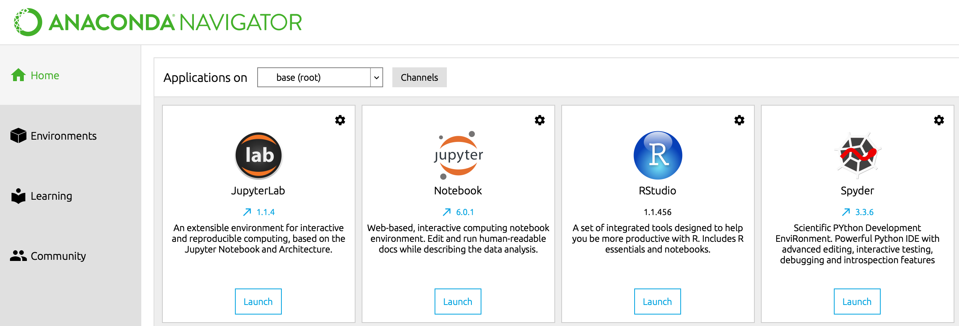
Open Anaconda Navigator and launch JupyterLab.

Slide 15
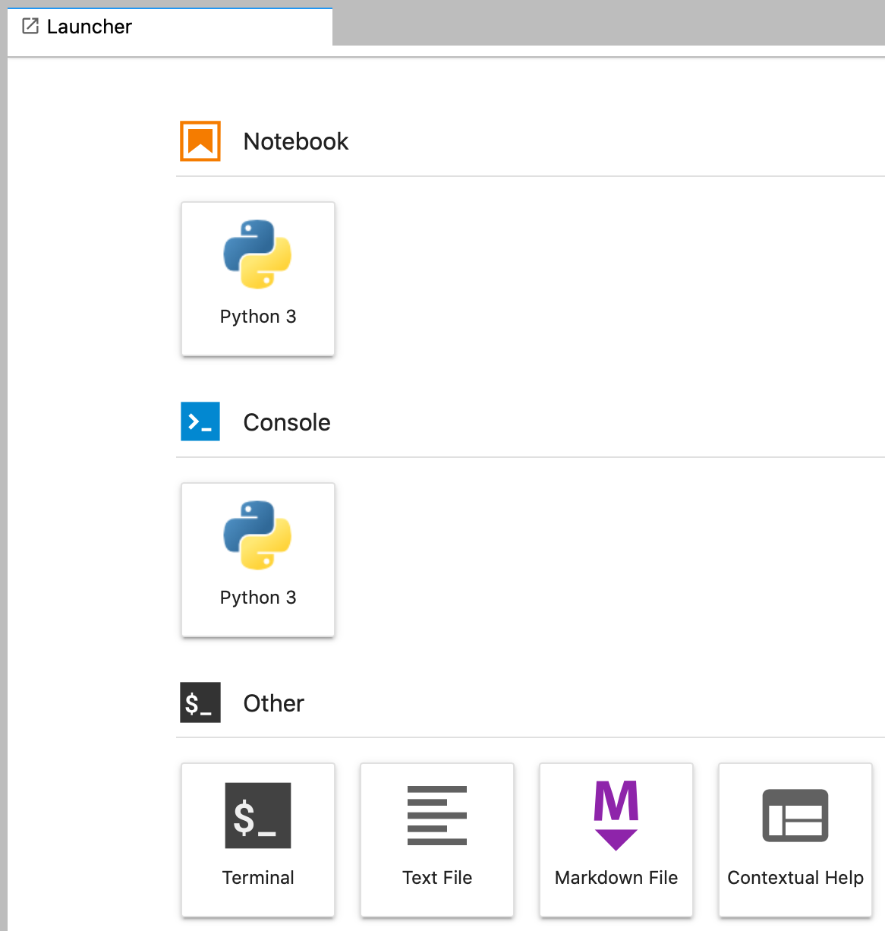
Open a new Python 3 notebook.

Slide 16
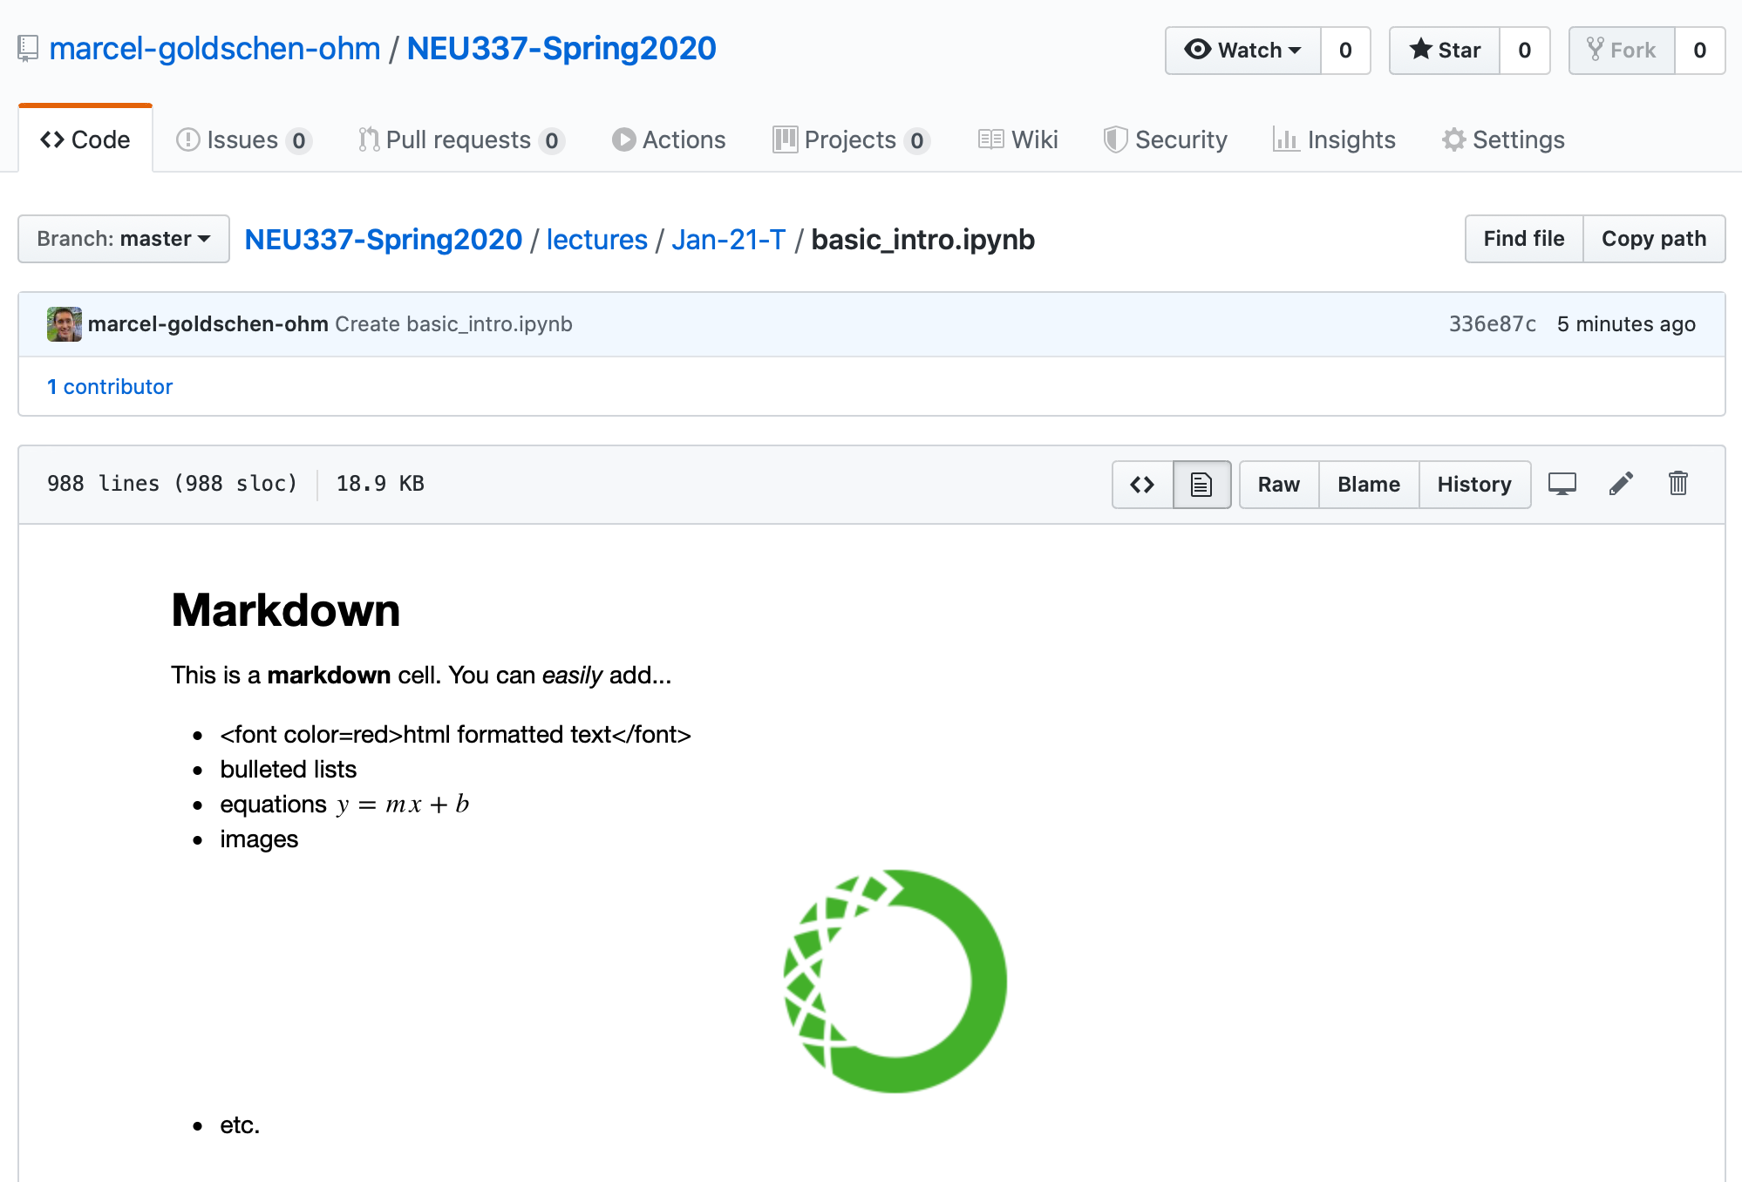
Download the Python 3 notebook basic_intro.ipynb.
Right-click and
Download Linked File
https://github.com/marcel-goldschen-ohm/NEU337-Spring2020

Slide 17
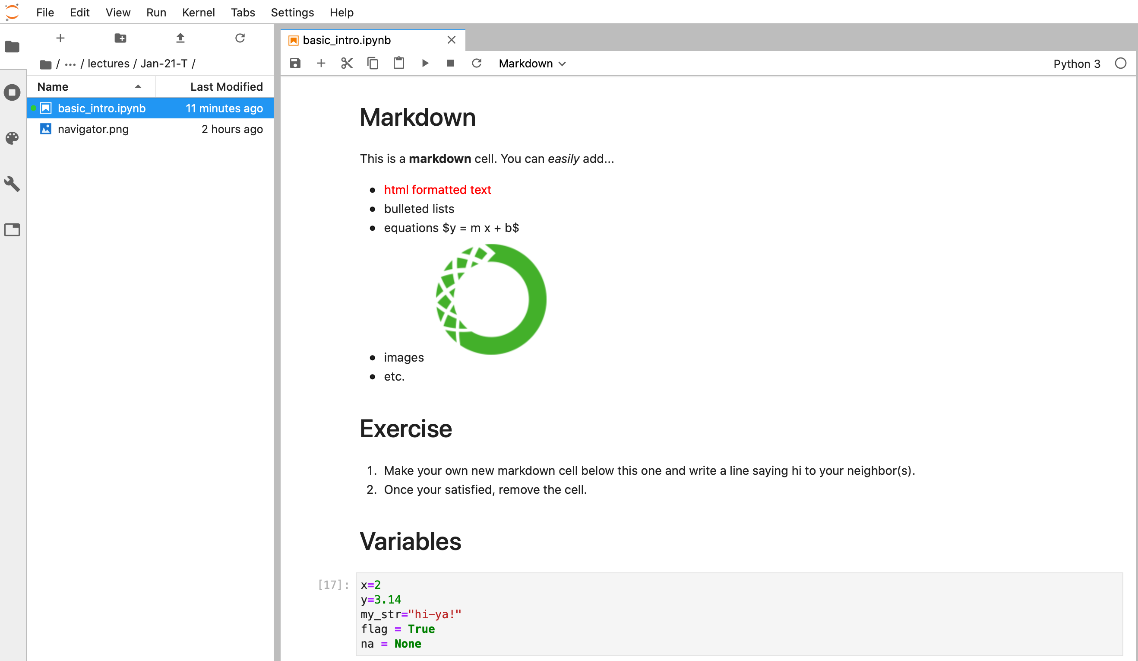
Navigate to and open basic_intro.ipynb in JupyterLab.

